Slide 1

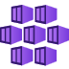
Introduction to AKS Automatic
Will Velida | @willvelida
Lead Software Engineer
Microsoft Azure MVP
October 2024
Notes:
Hey folks, my name is Will Velida – I’m a Lead Software Engineer at Mantel Group and Microsoft Azure MVP based in Melbourne. Great to see some familiar faces today, as I used to live in Auckland, but now I’m living in Melbourne where the Rugby is worse, but the coffee is better.
Today I’m here to talk about a new preview service called AKS Automatic ☺ Just out of interest, how many folks here use AKS? Use Kubernetes on another cloud or on-prem?
Ok, so today we’re just going to peak underneath the covers of AKS Automatic. The public preview was announced at Build earlier this year, so there’s some promising things I’ll go over today about wait AKS Automatic provides, and this will include what comes with AKS Automatic in terms of scaling, security, networking, things like that. And I’ll also point out what we currently CAN’T do with AKS Automatic

Slide 2

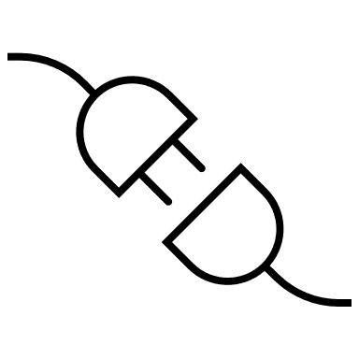

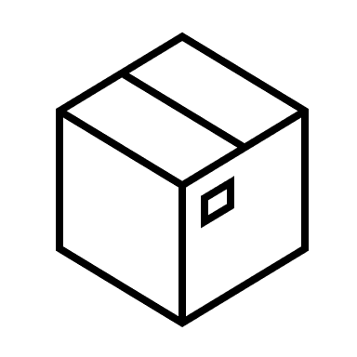
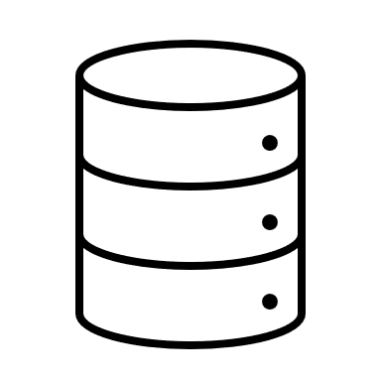
Starting with Kubernetes
Control Plane
Agent Nodes
Controller-manager
API Server
Scheduler
etcd
Notes:
But let’s start at the beginning with Kubernetes.
For those who may not know, Kubernetes is an open-source platform that enables you to deploy to manage containerized workloads and services at scale.
It provides a set of APIs for management operations, and has become the defacto container orchestration engine (It actually turned 10 this year)
At a very high level, Kubernetes architecture consists of a control plane and worker nodes. Without going into too much detail, when you deploy your own cluster with control plane, you’re in charge of configuring the control plane, all of its components and bootstrapping each worker node to join the cluster, which can be a lot of work.

Slide 3
AKS Standard
Azure Managed Control Plane
Agent Nodes
Notes:
So this is where AKS or Azure Kubernetes Service can take some of the burden off us.
AKS is a managed Kubernetes service in Azure that takes care of all the control plane components, so all we need to worry about is operating our containerized workloads within the worker node pool.
Now Kubernetes is highly extensible, and people rarely use Kubernetes without installing additional components. These include components for things like networking, monitoring, logging, security etc.
And one of the benefits/major issues of this is that….

Slide 4
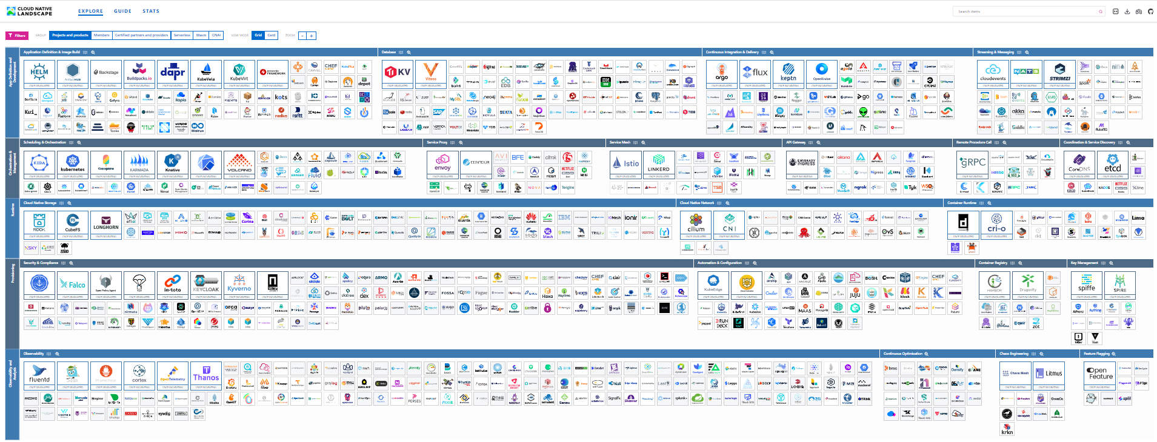
So much to choose from…..
Notes:
There’s a lot to choose from!
This is a screenshot of the Cloud Native Computing Foundation landscape site that I had to scroll out to 25% just to try and fit all of these in one page.
Now don’t get me wrong, if you’re starting out this is a great place to come and see what’s available to your Kubernetes cluster, however this can be overwhelming (I wonder if there’s more CNCF components than JavaScript frameworks?)

Slide 5
AKS Automatic
Streamlined cluster operations
Faster time to business values
Improved Security posture
Lower total cost of ownership
Notes:
So what the AKS team have done is introduce a new offering called AKS Automatic
The objective of AKS Automatic is provide a lean offering of AKS with many of these components installed and configured by default.
This provides us with a streamlined experience of setting up our AKS cluster. So instead of having to figure out what components we need for security, logging, monitoring etc. AKS Automatic provides us with these components already that are aligned to best practices around configuring our AKS cluster

Slide 6
What comes out of the box?
Security | Networking | Autoscaling | Observability
Cluster Azure Linux Automatic upgrades Azure RBAC enabled Local access disabled SSH access disabled Workload identity enabled Image cleaner add-on NRG lockdown Workload Deployment safeguards Azure Policy add-on Azure Key Vault provider add-on | Pod Azure CNI Overlay powered by Cilium Ingress App Routing add-on Egress NAT Gateway | Cluster Node Auto provision Workload KEDA add-on VPA add-on | Metrics Managed Prometheus Logs Container Insights Visualization Azure Managed Grafana Container Insights workbooks Azure Policy Dashboards Alerts Prometheus alert rules Azure Action Groups
Notes:
So what actually comes with it? Let’s divide into a few sections
In terms of security, at the cluster level, AKS Automatic uses Azure Linux OS along with Automatic upgrades. Local access and SSH access is disabled, with Azure RBAC being enabled to access the Kubernetes API. Workload identity is enabled so that our developers can build applications that authenticate to Azure resources using Entra ID for passwordless experiences. Image cleaner add-on are already configured for you and the node resource group is locked down to prevent users from accidently or intentionally making changes to the cluster.
There are also deployment safeguards configured for you, as well as both the Azure Policy and Azure Key Vault provider add-ons so that you can work with secrets and policies from day 1.
When it comes to networking, we can think of how Pods communicate with each other and how traffic ingresses and egresses from the cluster. For pod networking, AKS Automatic implements the Azure CNI overlay networking with Cilium. For the data cplane, ASK App Routing add Is configured for ingress which is essentially a managed ngix Ingress controller which can integrate with Azure DNS. For Egress, AKS NAT Gateway is installed for scalable outbound connection flows. Service meshes aren’t enabled by default, but you can use either your own service mesh or Azure service mesh.
AKS Automatic autoscaling is enabled by AKS Node Autoprovisioning which is based on the open-source Karpenter project that automatically provisions and deprovision nodes based on workload demands. The cluster autoscaler routinely checks for underutilized nodes and scale accordingly to save you from wasting resources. AKS Automatic also adds KEDA and VPA add-ons. So for KEDA, we can scale our clusters based on events and metrics, and the VPA (Vertical Pod Autoscaler) will essentially help us automatically adjust resource requests based on actual usage.
Finally for observability (starting to get into the day 2 stuff), AKS Automatic integrates with Azure Managed Prometheus for metric collection, Container Insights for log collection, and Managed Grafana for visualization.
With Managed Grafana, it’ll come with several Kubernetes and Azure related dashboards already installed so you can see how the cluster is operating just by going into your Grafana dashboards.

Slide 7
Let’s dive in!
https://github.com/willvelida/my-aks-cluster

Slide 8
Things to note
Still in Preview (Not prod ready just yet)
No AzureRM provider support in Terraform, just AzApi
Monitoring is only wired up when deploying via CLI or Portal.
BYO-Network not there yet.
There’s an even easier way to deploy containers in Azure…

Slide 9





Let’s connect
willvelida.com
github.com/willvelida
twitter.com/willvelida
linkedin.com/in/willvelida
youtube.com/@willvelida

